Slide 1

Captcha Cracker
Captcha image automatic recognition deep learning model
김영진 이재호 이찬규 고채린 추서연

Slide 2

1. Captcha
2 Captcha Cracker
3. OCR, CNN, RNN, CTC Loss
4. RESULT
5. Limitation

Slide 3
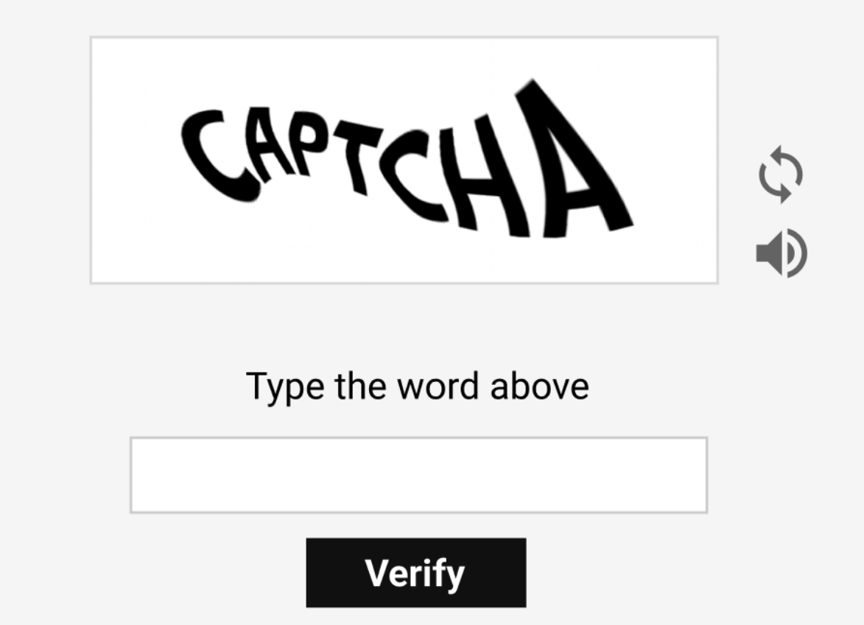
Captcha
Completely Automated Public Turing Test To Tell Computers and Humans Apart

Slide 4
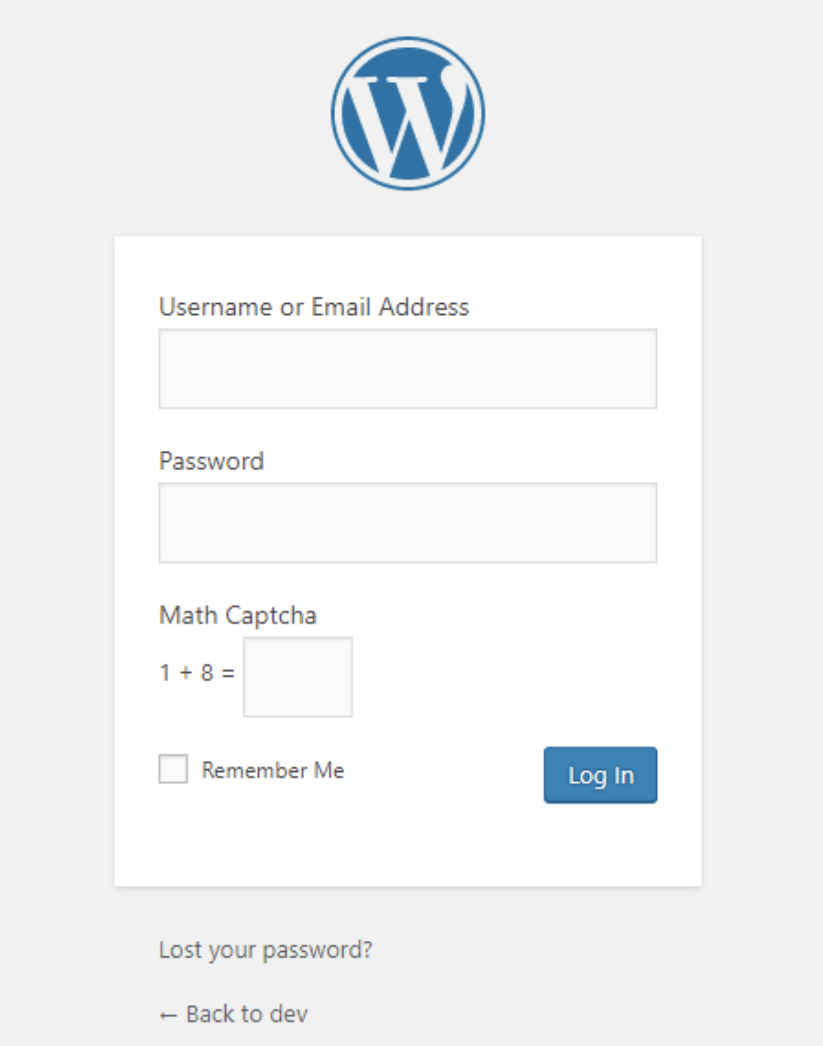
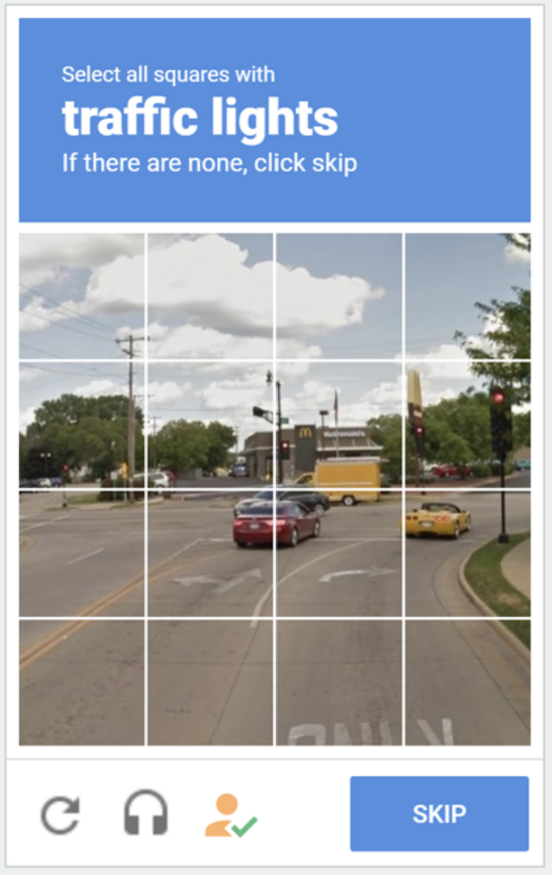
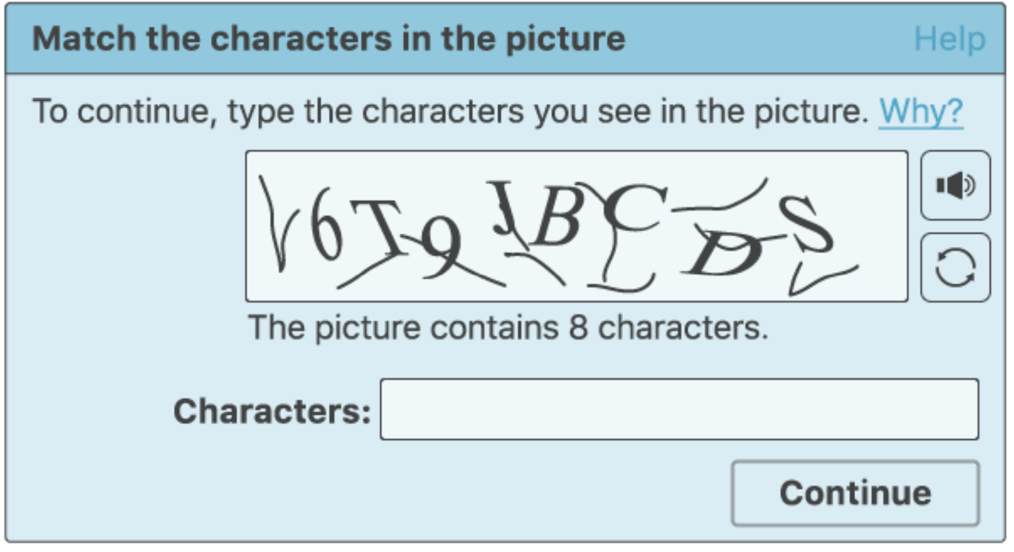
Captcha
text captcha
image captcha
math captcha

Slide 5

text captcha
1.Captcha program presents images of distorted characters and numbers
2.User input the same text as the presented image
3. System distinguishes between humans and bots by matching text

Slide 6
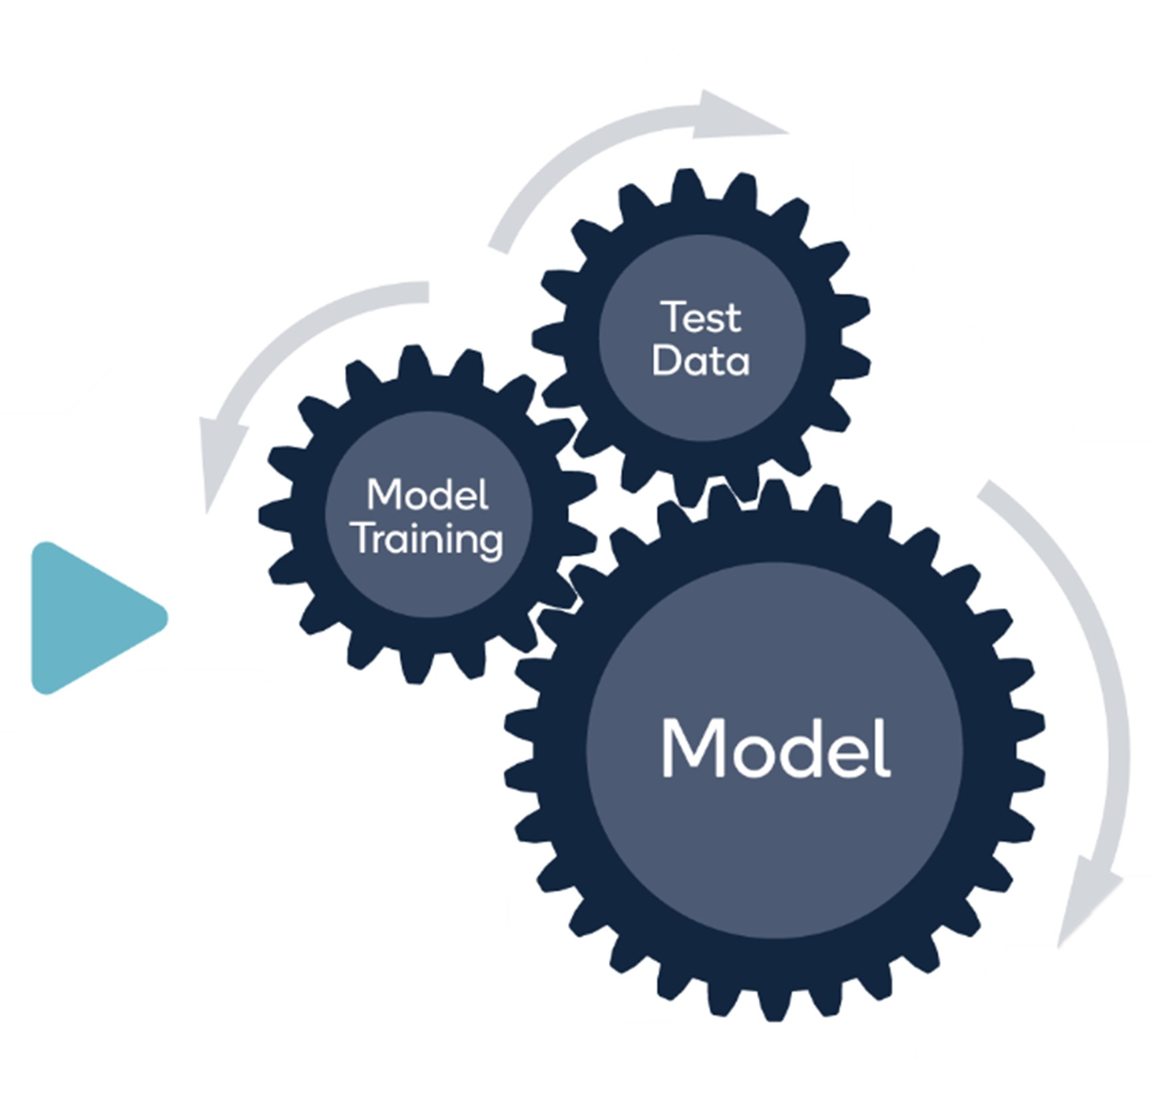
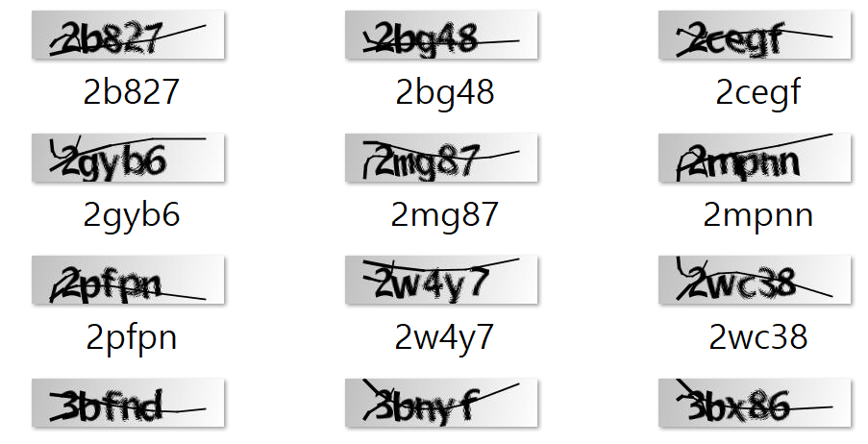
Captcha cracker
automatic recognition model

Slide 7
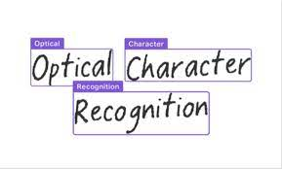
Optical Character Recognition
The process of converting a text image to a text format
Convolutional Neural Network
Long-Short Term Memory
Connectionist Temporal Classification Loss

Slide 8
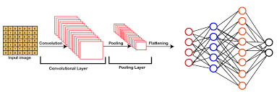
Convolutional Neural Network
mimics the structure of a human optic nerve
Used by Computer Vision
Convolution Layer, Pooling Layer, Fully Connected Layer, Softmax Layer

Slide 9
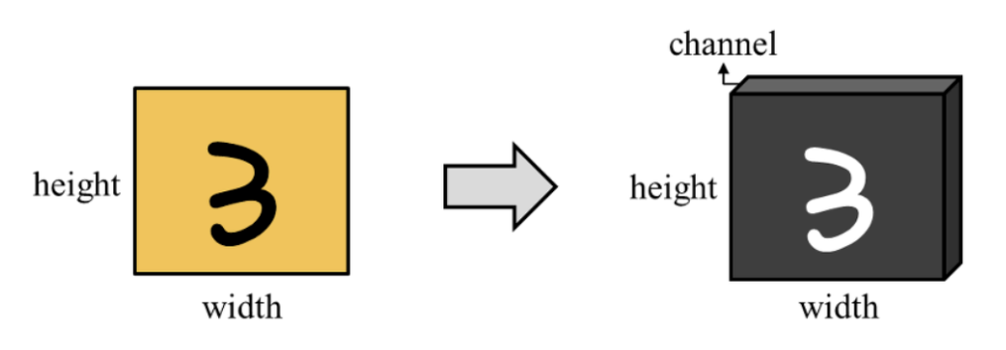
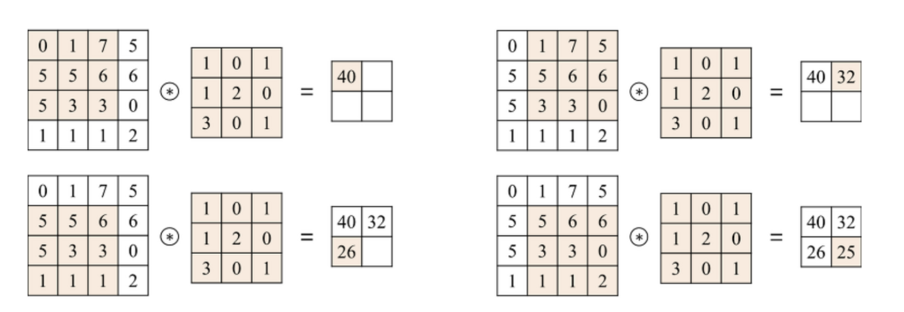
Convolutional Neural Network - Convolution Layer
Filter exists as many channels in the image, apply a filter to each channel to create an output image

Slide 10
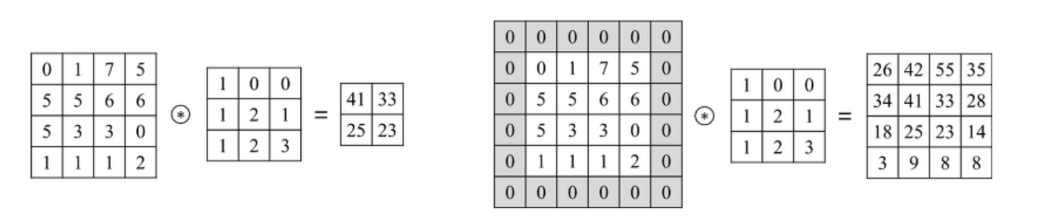
Convolutional Neural Network - Convolution Layer
Using zero-padding to keep the same size in captcha cracker

Slide 11
Convolutional Neural Network - Pooling Layer
Max Pooling
Average Pooling
Min Pooling

Slide 12
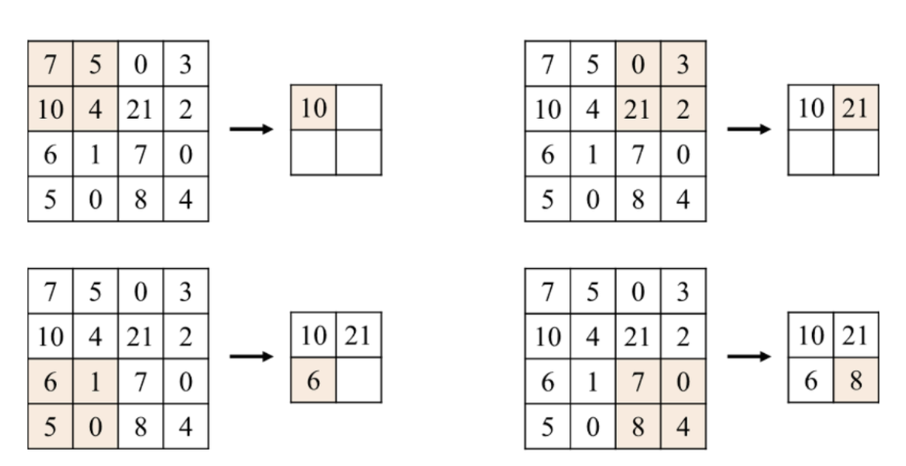
Convolutional Neural Network - Max Pooling
Gets only the largest value within the selected area
We select 2x2 area
-> half size
Reduces noise, speeds up and increases discernment.

Slide 13
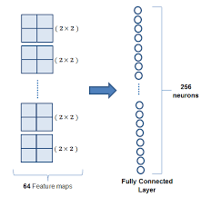
Convolutional Neural Network - Fully Connected Layer
Role of changing Tensor to Vector
Required for data classification operations

Slide 14
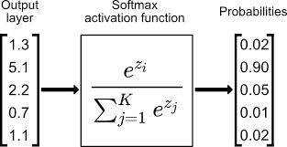
Convolutional Neural Network - Softmax Layer
Represents probability for classification for each element

Slide 15
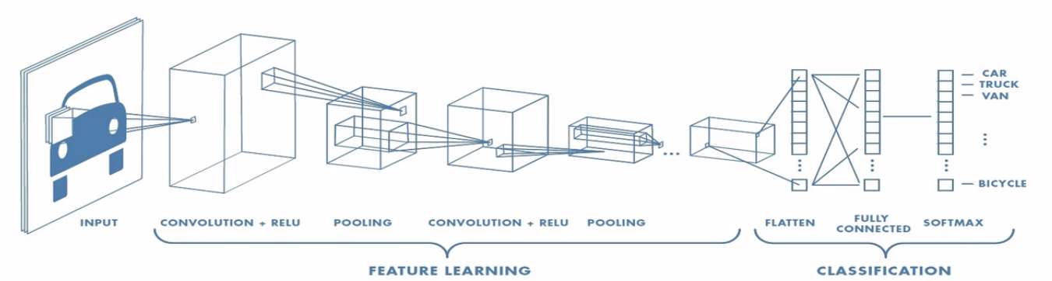
Convolutional Neural Network
It is important to combine each layer properly.

Slide 16
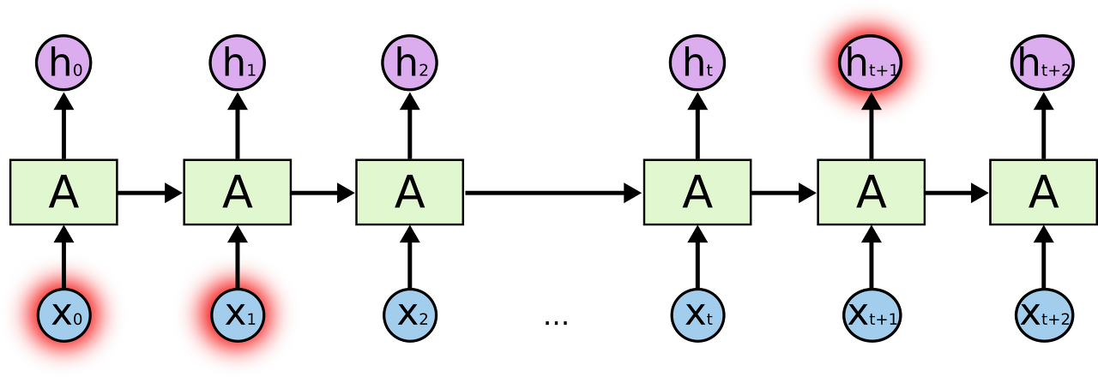
Long-Short Term Memory
RNN has a long-term dependencies.
Information comes out too early to reach the backend.
LSTM compensates for the weakness of these RNNs

Slide 17

Long-Short Term Memory
Forget Gate Layer
Input Gate Layer
Cell State Update
Output Gate Layer

Slide 18
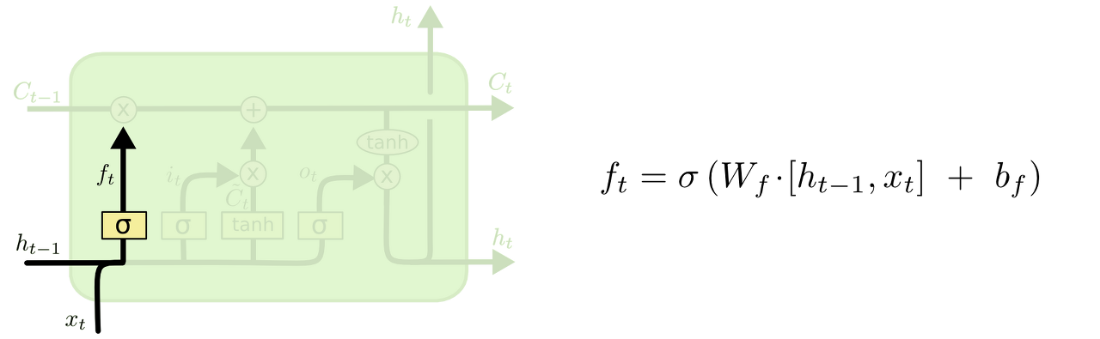
Long-Short Term Memory - Forget Gate Layer
Decide what information to discard from Cell state If it is 0, discard it, and if it is 1, save it.

Slide 19
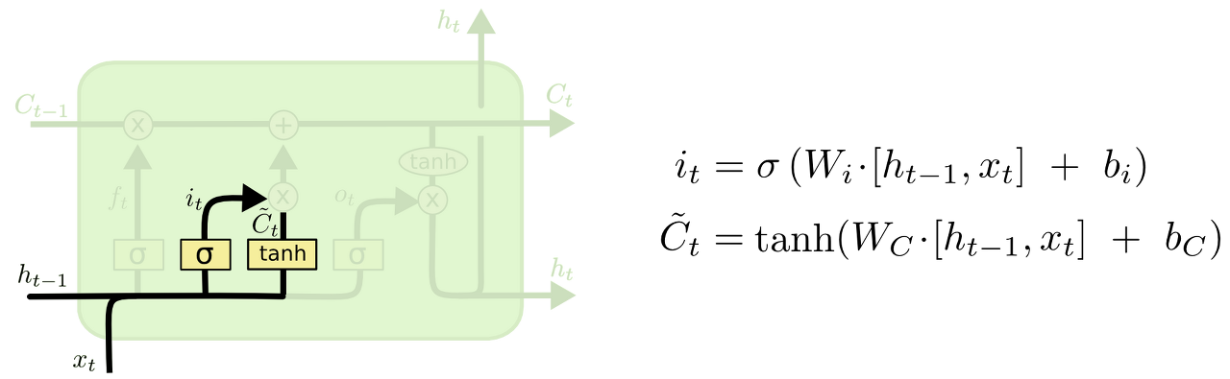
Long-Short Term Memory - Input Gate Layer
Decide which of the new information you want to store in the cell state.

Slide 20
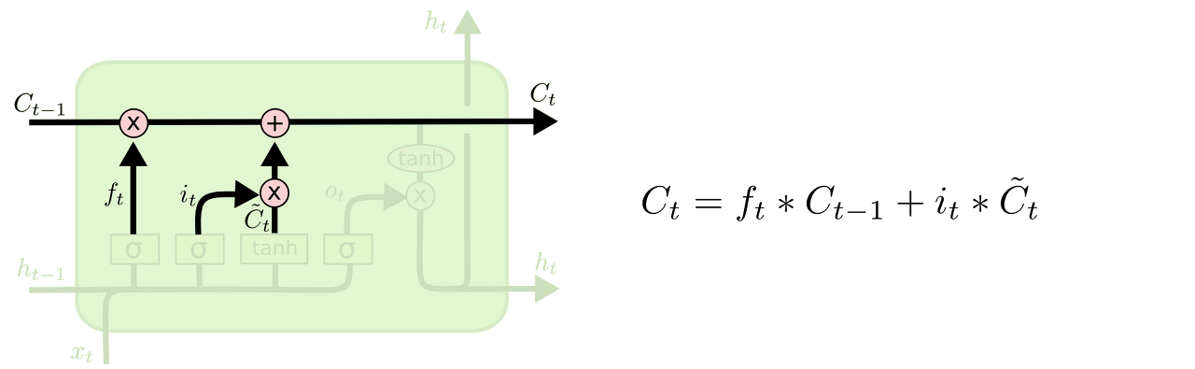
Long-Short Term Memory - Cell State Update
Update decisions made in the last step

Slide 21
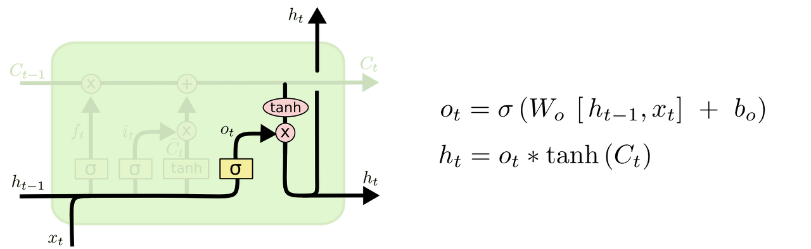
Long-Short Term Memory - Output Gate Layer
Decide which part to send as output to Cell state

Slide 22
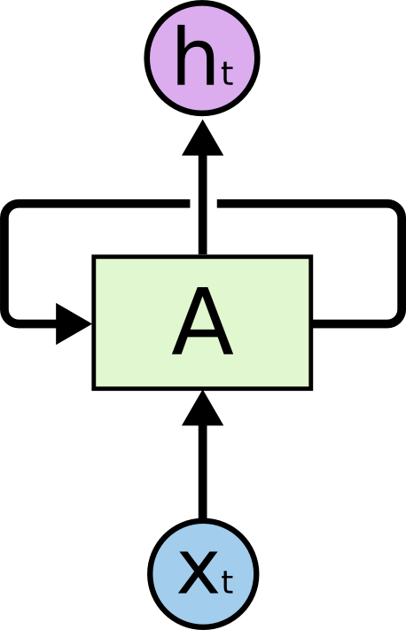
Connectionist Temporal Classification Loss
RNN requires segmented data
-> Difficult to create a lot of data for segmentation
CTC can learn the unsegmented data.
Complements the weakness of RNN

Slide 23
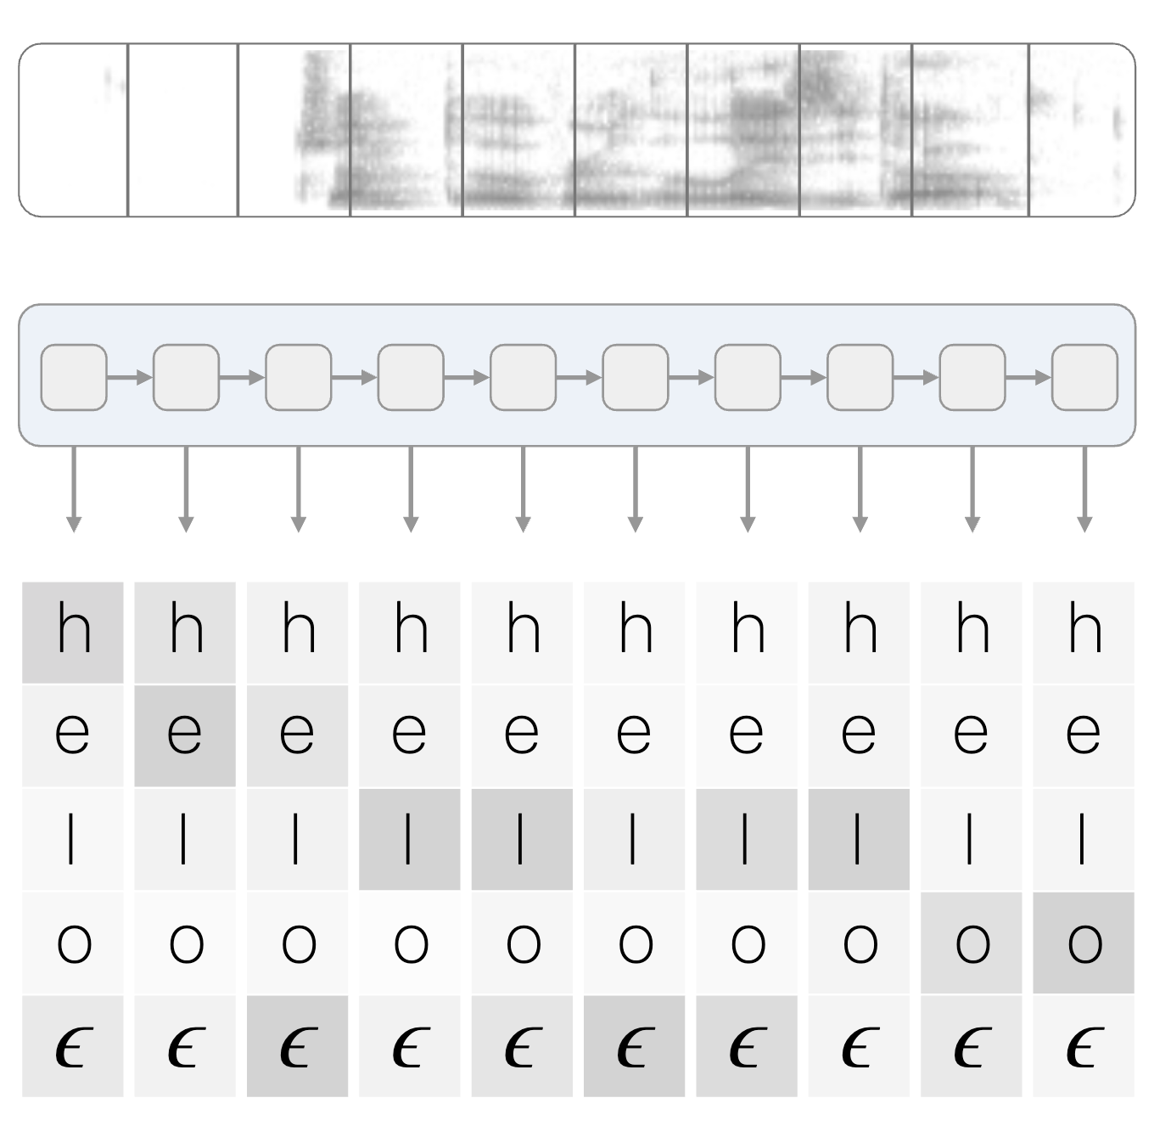
Connectionist Temporal Classification Loss
Used for voice file or handwriting recognition
Adjust length and segmentation using blank
Remove blank and duplication
-> Create characters
-> hello

Slide 24
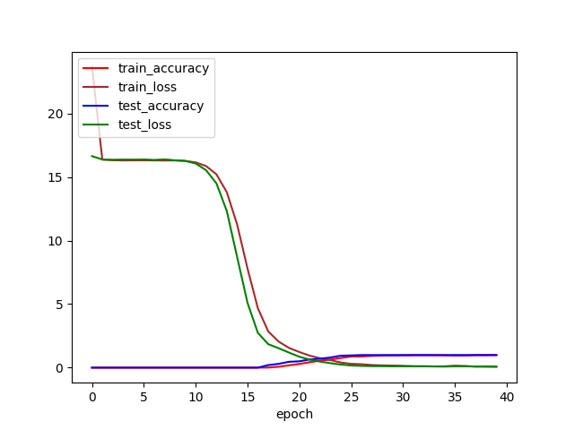
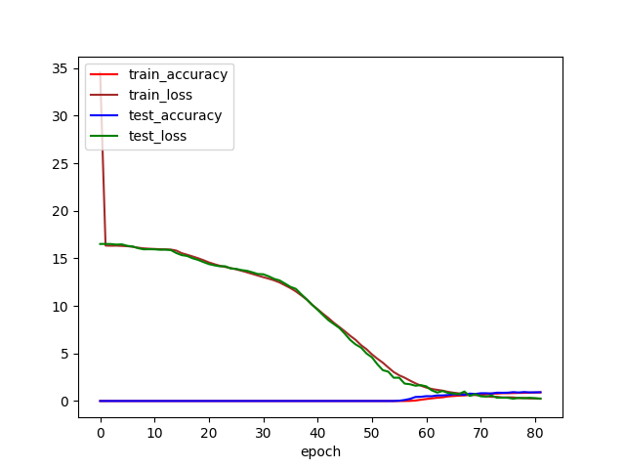
Result - Training & Validation
lr = 0.001
Adam
SGD

Slide 25
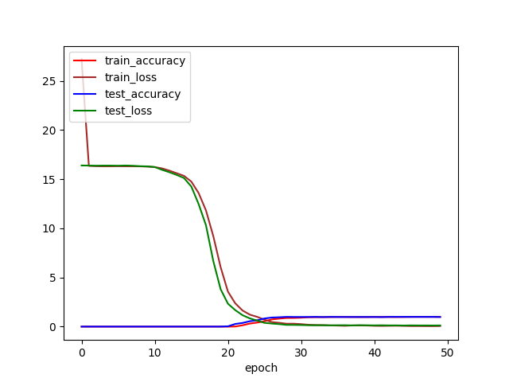
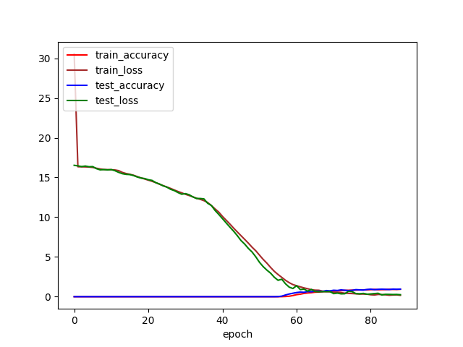
Result - Training & Validation
lr = 0.003
Adam
SGD

Slide 26
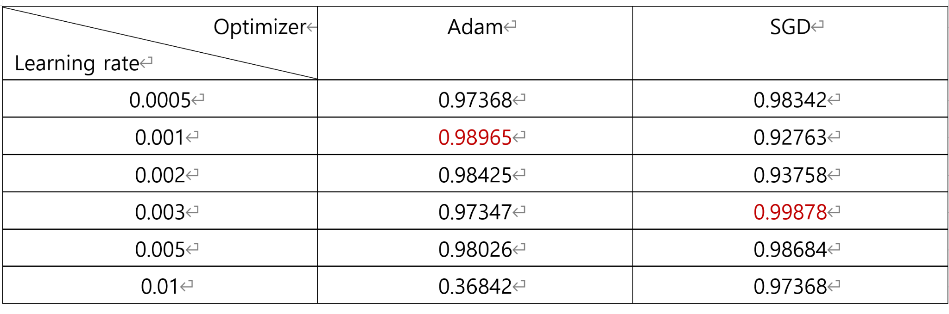
Result - Training & Validation

Slide 27
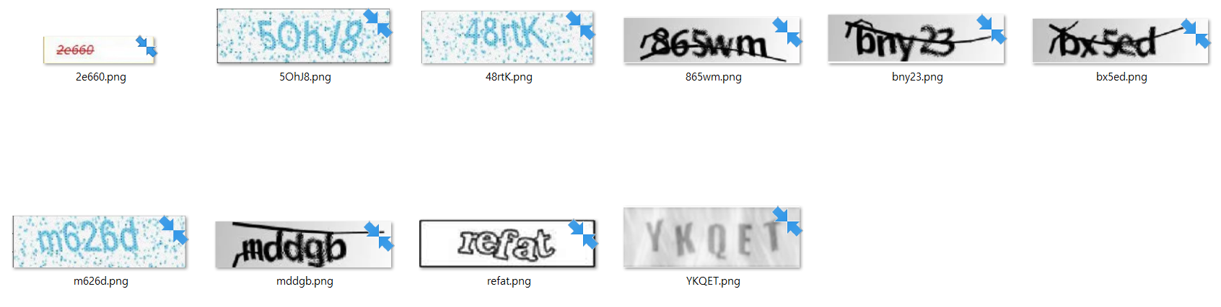
Result - Existed model Test
We put a CAPTCHA image found on Google into this model and tested it.

Slide 28
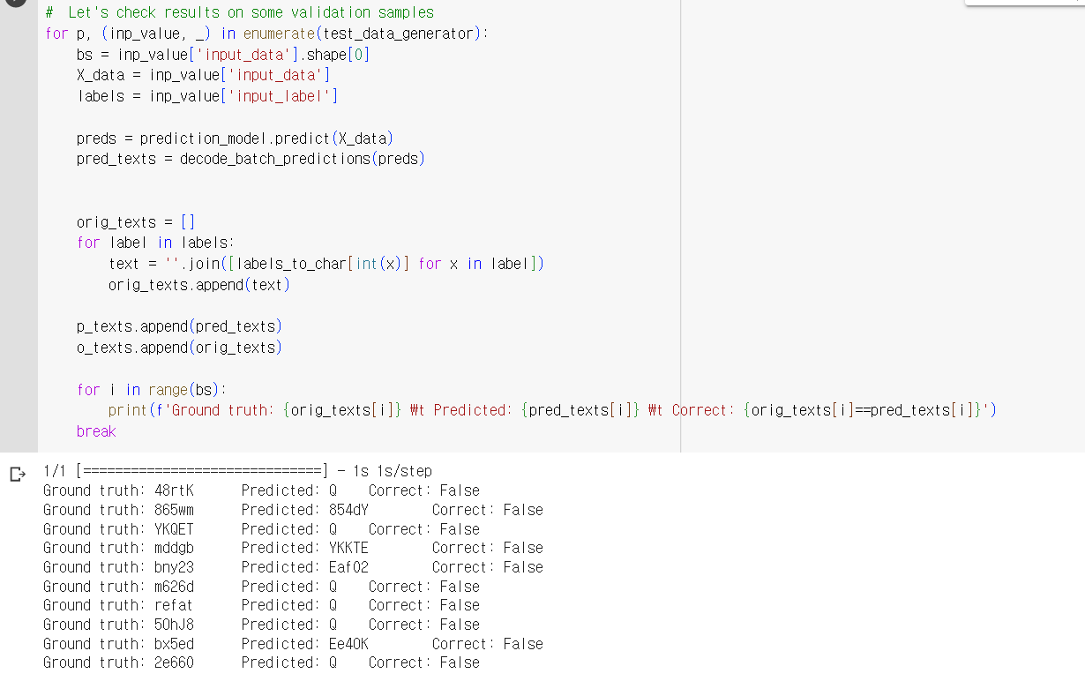
Result - Existed model Test

Slide 29
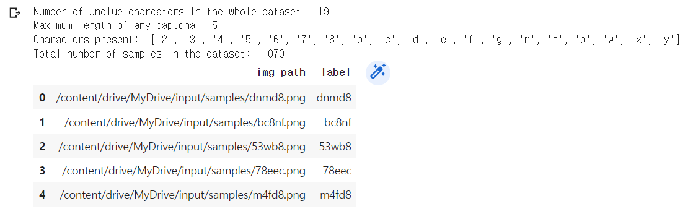
Limitation
In the exist code, Due to the lack of data, it was not possible to train using a sufficient amount of data. In this model, since the number of letters and numbers is limited to 19, it is not possible to predict other types of letters and numbers.

Slide 30
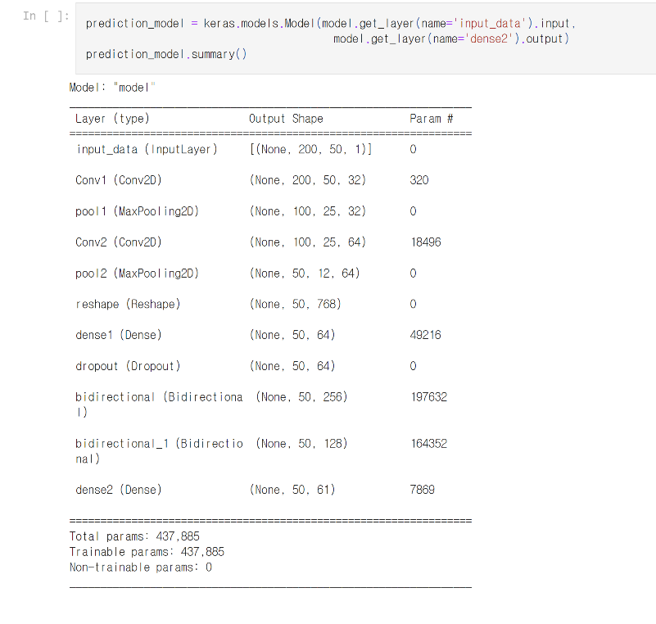
Result - model

Slide 31
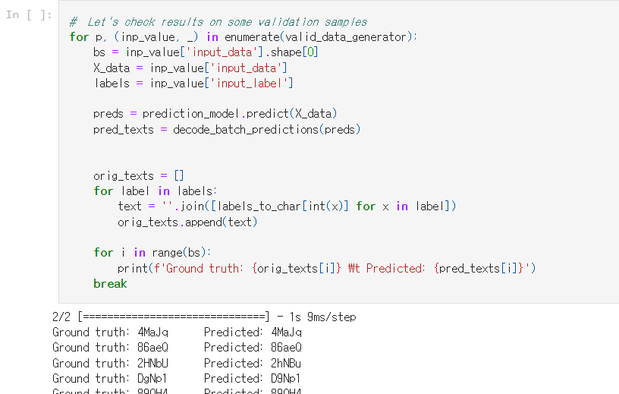
Result - Test
https://github.com/Captcha-Recognition-Team/Captcha-Recognition/blob/main/building-a-captcha-ocr-in-tf2-0.ipynb

Slide 32
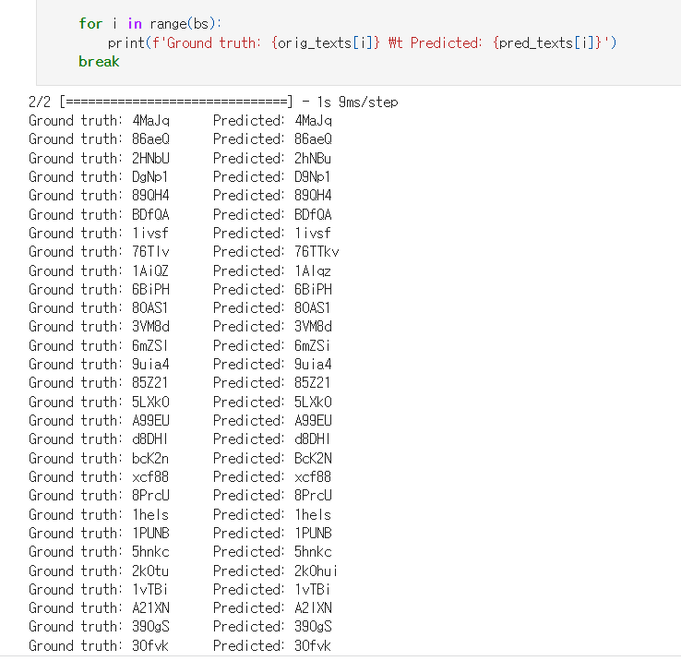
Result - Test

Slide 33
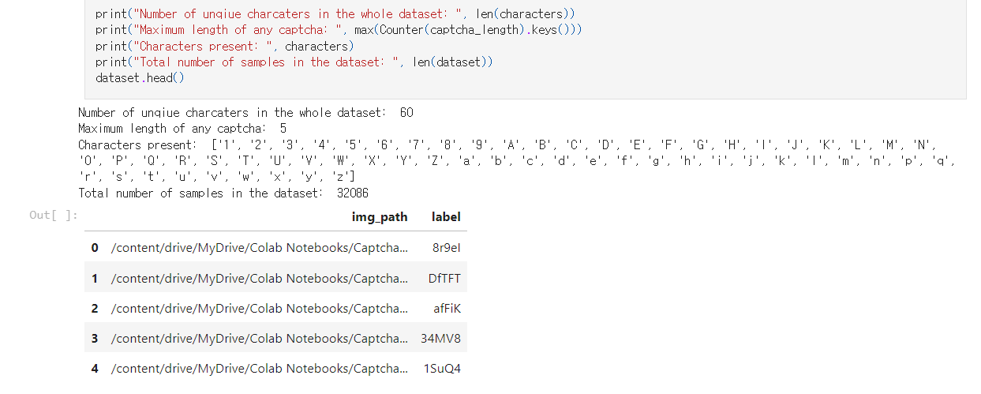
Limitation
We added more data to make it recognizable to all numbers and letters except 0 and o. But the captured image taken from the actual site has different data from the trained one, so accuracy cannot be predicted.

Slide 34
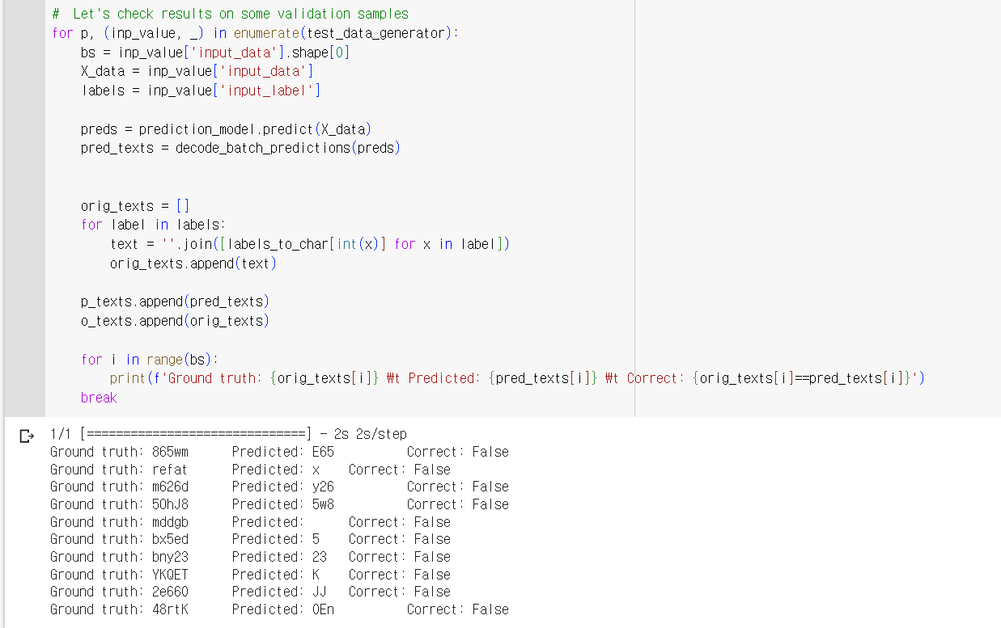
Result - model comparison & analysis
Existing model
model with data added
The right side recognizes the letters more.

Slide 35
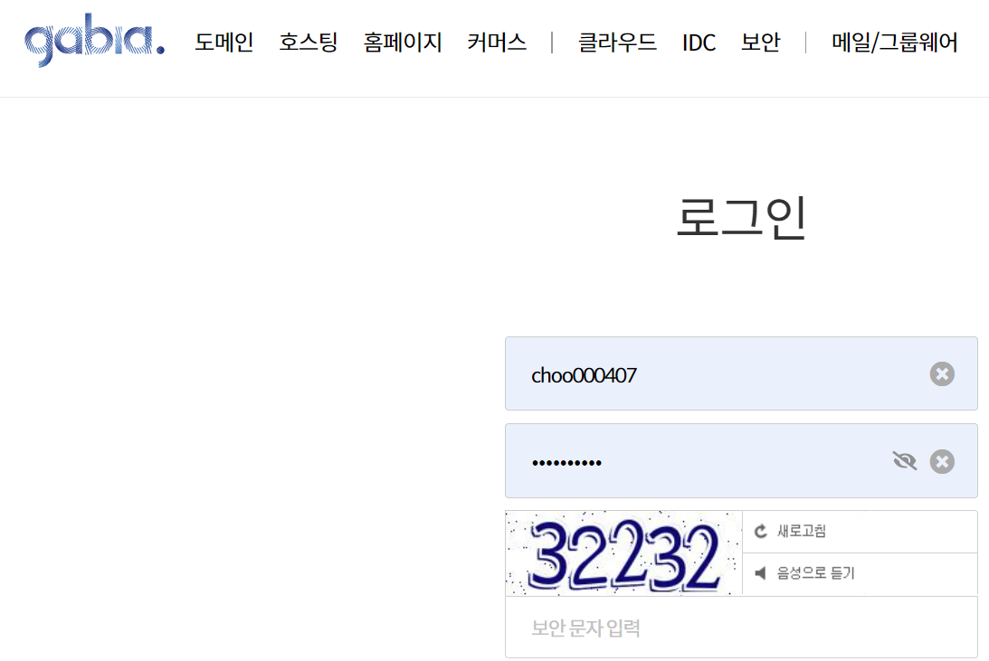
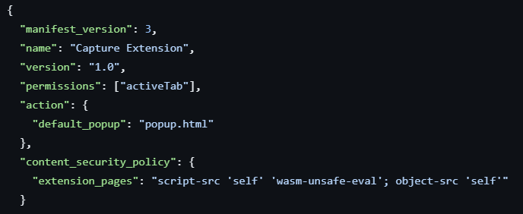
Limitation - application in actual site
We tried to apply the image to the model using an extension program on the actual site, but it was difficult due to security issues.
Chrome extension program development.
Try 1) Crawling to get Captcha images and load them into the model
Limitation) Captcha image url was retrieved by crawling, but it was not available because the site set the URL to host a new image every time instead of hosting a fixed image.
Manifest code for extension development
Image URLs by Gabia crawling
https://captcha.gabia.com/captchahandler/index?get=image&amp;c=gcaptchaapi&amp;t=9cf926856d868a9c2b3dce03c504b1be

Slide 36
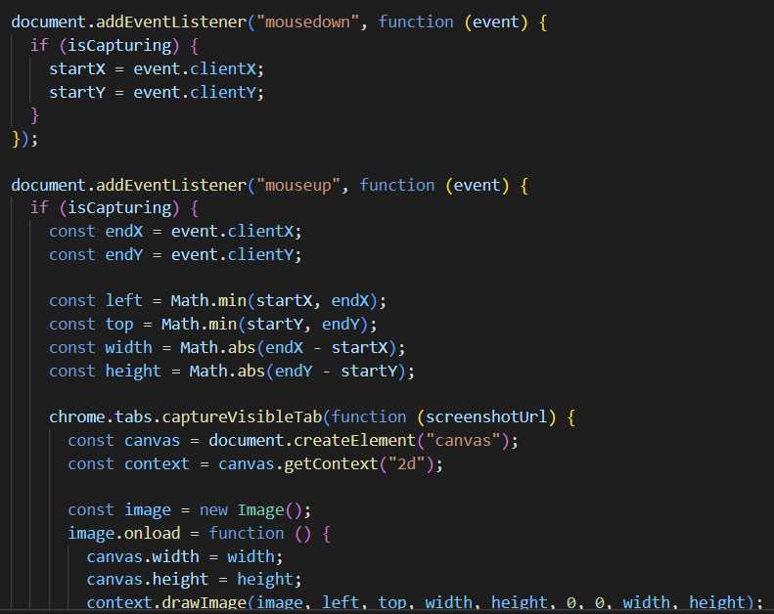
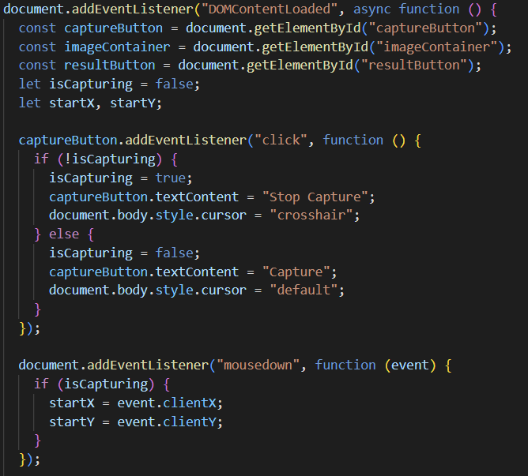
Limitation - application in actual site
Try 2) Capture the Captcha image yourself and load it into the model using Tensorflow.js
Limitation) It was successful to specify and capture the area the user wanted and save the image, but in order to use Tensorflow.js, all the existing test Python code had to be rewritten, so I found another way.
Code to capture image

Slide 37
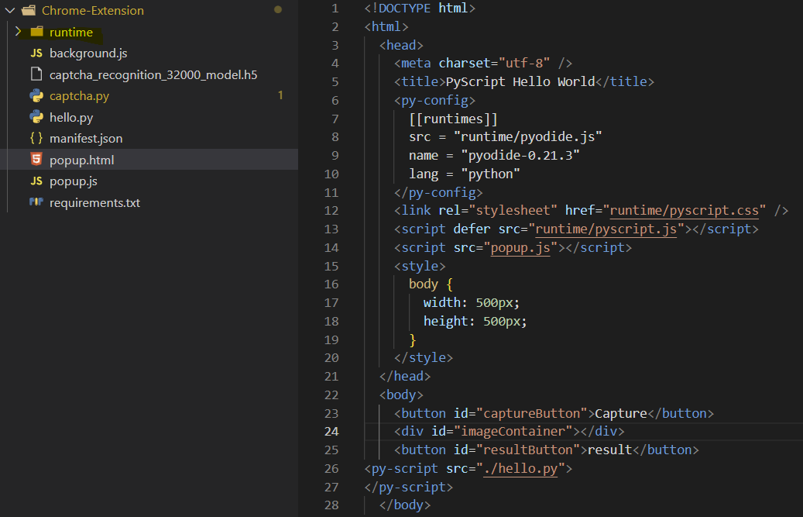
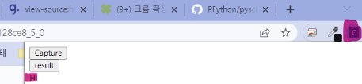
Limitation - application in actual site
Try 3) Captcha images are captured by the user and loaded into the model using PyScript
Using PyScript, we can run Python files from html.
We ran the Python file that was tested by loading the image into the model.
Pyscript is not available for security reasons in Chrome extension programs. As a result, open source, which created a Pyscript execution environment directly in the Chrome extension program, enabled simple Phthon code execution, but modules such as opencv and numpy could not be executed.
open source code used
https://github.com/PFython/pyscript-local-runtime
- Add the runtime folder to your project,
It can be used by putting related setting codes in html.
- Result of executing the Python code with the “print(“hi”)” code

Slide 38
Demo - Application in Actual Site
Demo of a chrome extension that captures and saves images
Due to Chrome extension security regulations, it is not possible to specify a path to download images separately, so they are stored in the download folder.

Slide 39
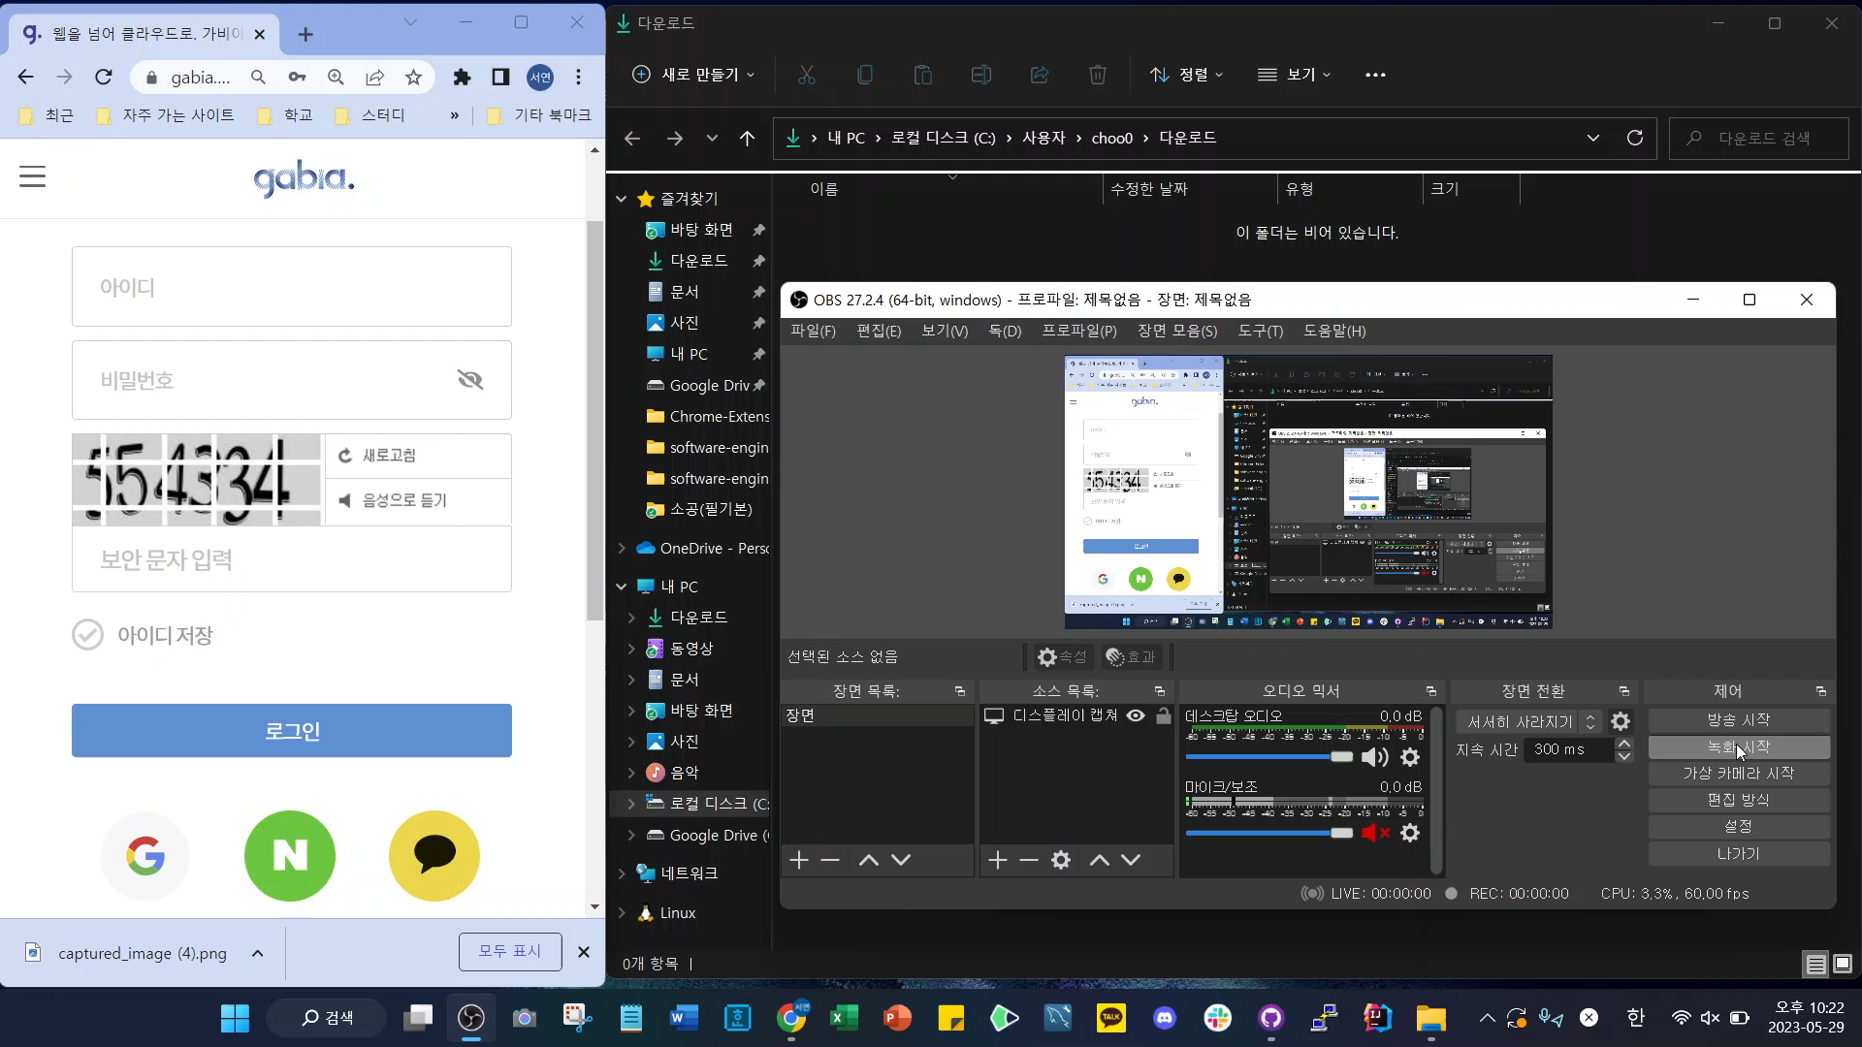

Slide 40
References
https://rubber-tree.tistory.com/entry/딥러닝-모델-CNN-Convolutional-Neural-Network-설명
https://dgkim5360.tistory.com/entry/understanding-long-short-term-memory-lstm-kr
https://hulk89.github.io/machine learning/2018/01/30/ctc/
Connectionist Temporal Classification(CTC) |작성자 sogangori
https://ratsgo.github.io/speechbook/docs/neuralam/ctc
https://www.kaggle.com/datasets/fournierp/captcha-version-2-images
https://keras.io/examples/vision/captcha_ocr/
https://www.kaggle.com/code/aakashnain/building-a-captcha-ocr-in-tf2-0

Slide 41
Thank You!

